Slide 1

LOK SABHA ANALYSIS 2019

Slide 2
CONTENT
EDUCATION
STATE
PARTY
CONSULTANCY

Slide 3
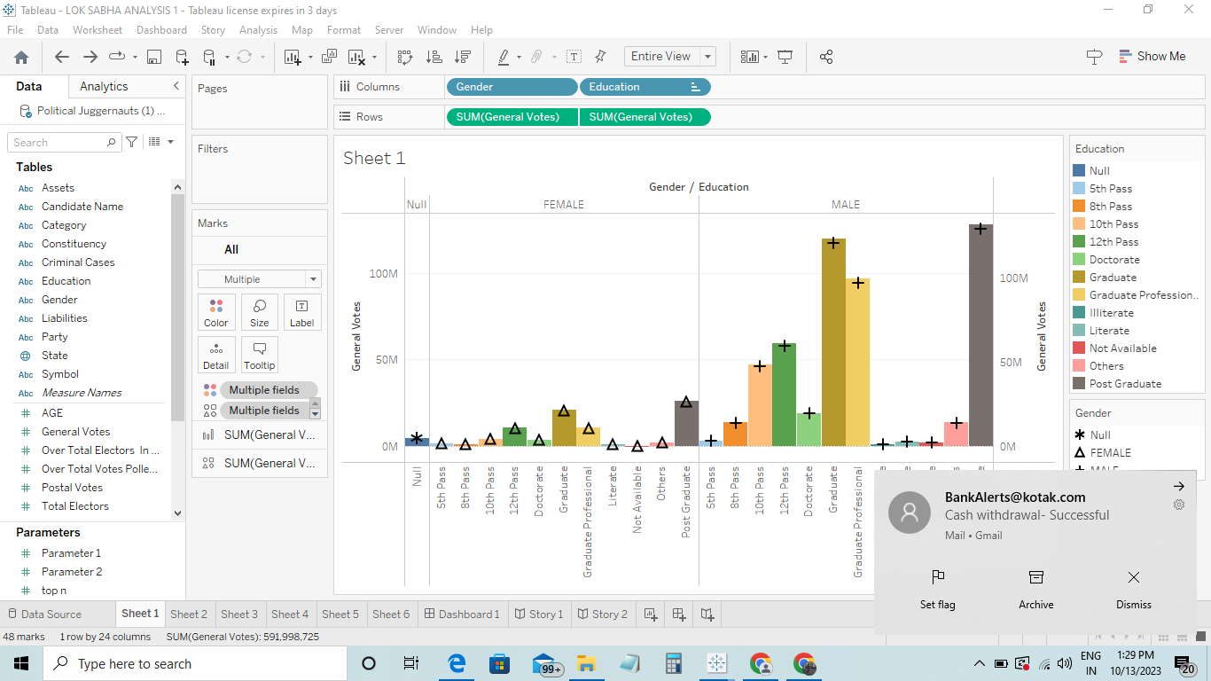

Slide 4
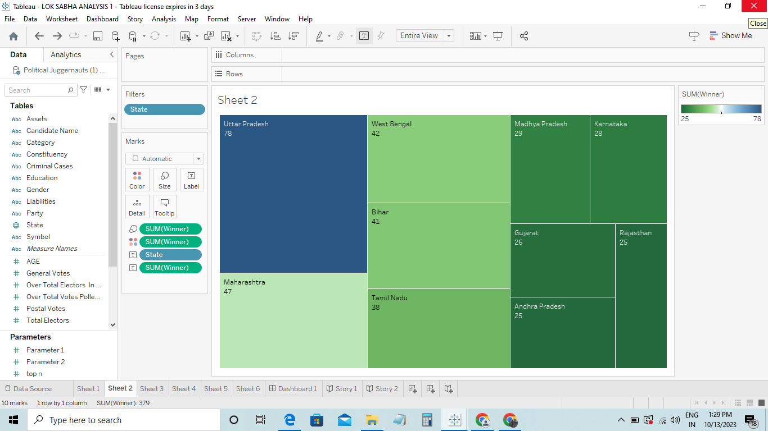

Slide 5
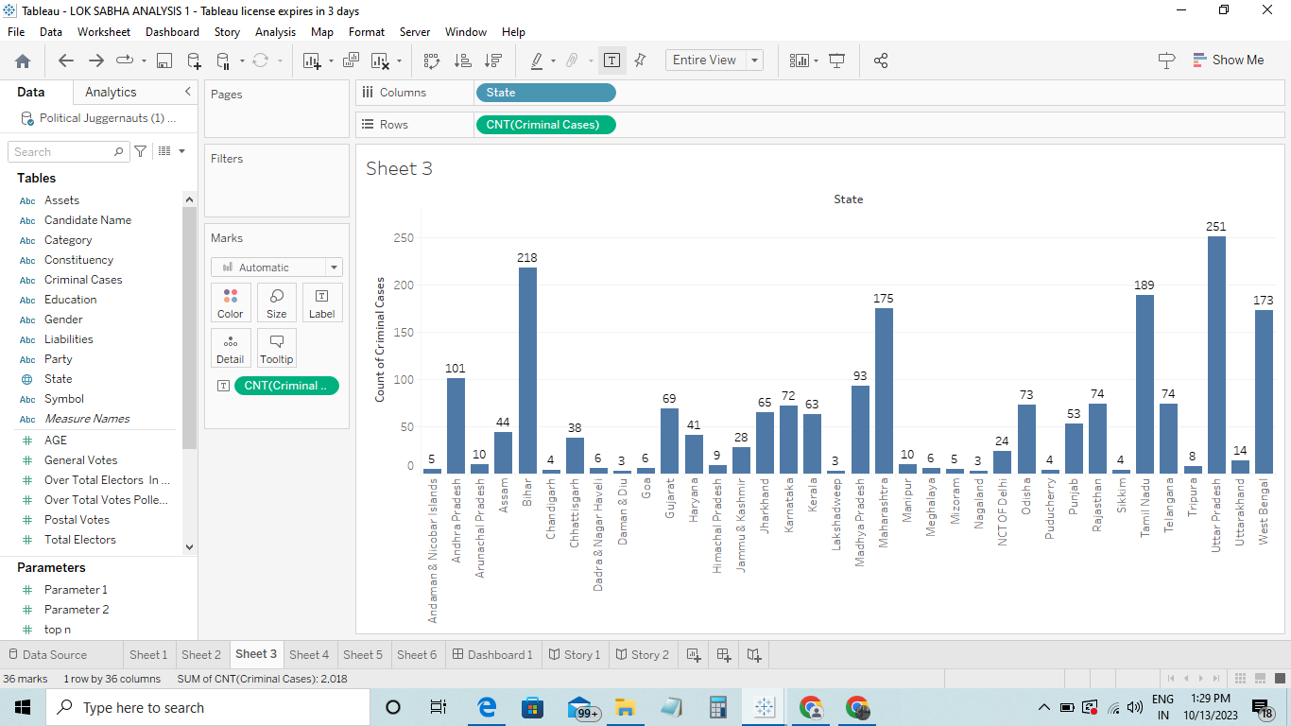

Slide 6
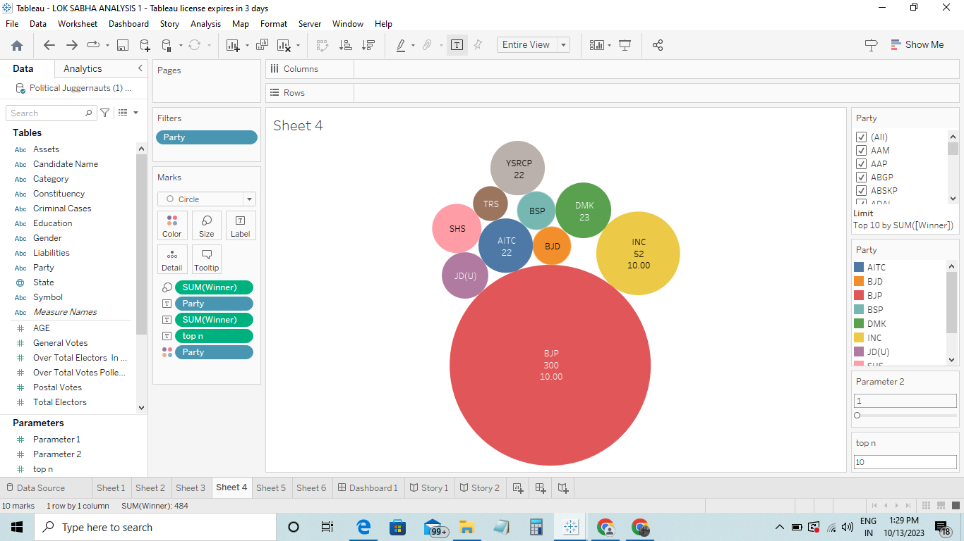

Slide 7
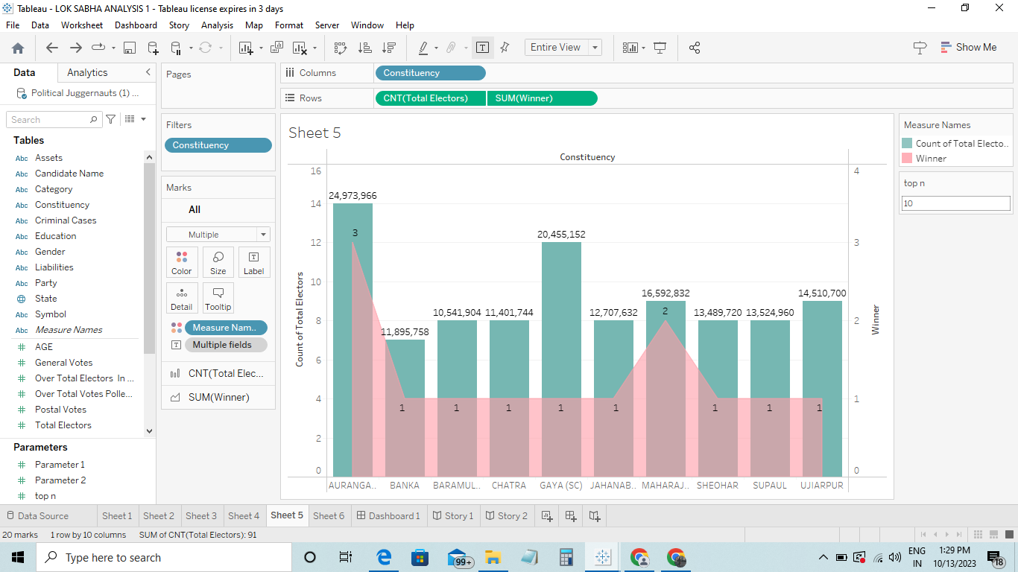

Slide 8
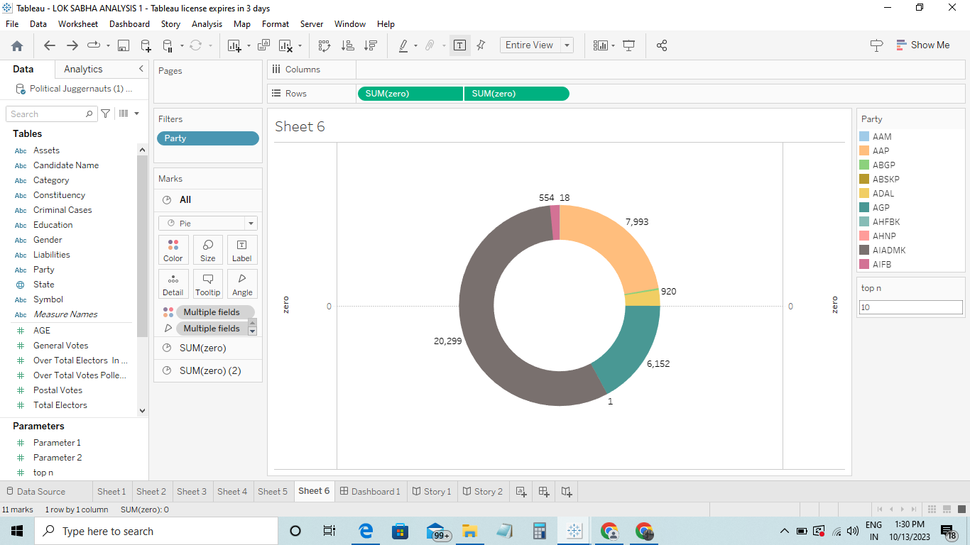

Slide 9
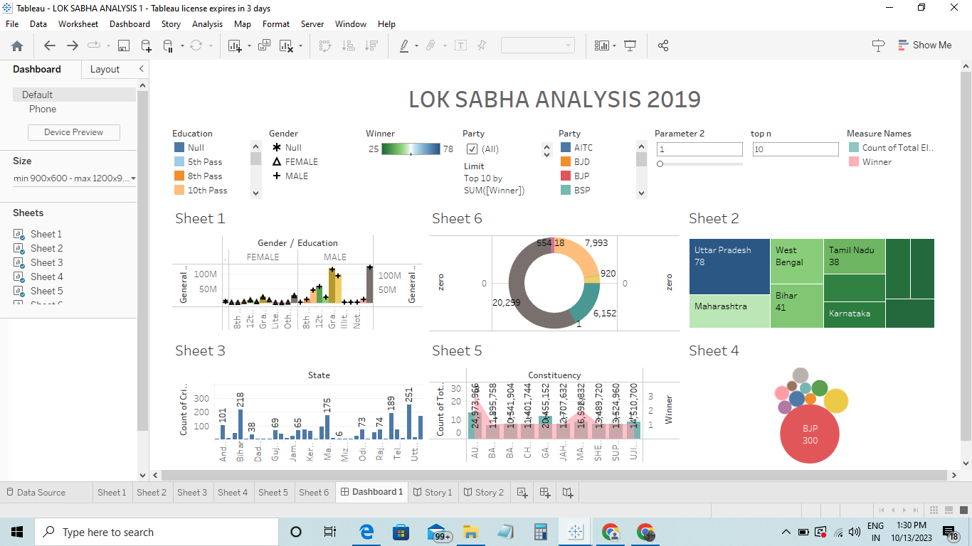

Slide 10
THANK YOU

